Slide 1
Breast Cancer Classification Using Different Classification Models
Cancheng Ji, Jiexi Zhou, Sean Cancino

Slide 2
Data Description
Data Source: https://www.kaggle.com/uciml/breast-cancer-wisconsin-data and also https://archive.ics.uci.edu/ml/datasets/Breast+Cancer+Wisconsin+%28Diagnostic%29
Description: To predict whether the breast mass is malignant:
Attribute: Diagnosis (M=Malignant B=Benign)
Features: The mean, standard error and "worst" or largest of the 10 features: radius, texture, perimeter, area, smoothness, compactness, concavity, concave points, symmetry, fractal dimension
So there are 30 features

Slide 3
Train Test Split
Used 70% training, 30% test, random seed = 202012
Training set contained 398 observations
Test set contained 171 observations

Slide 4
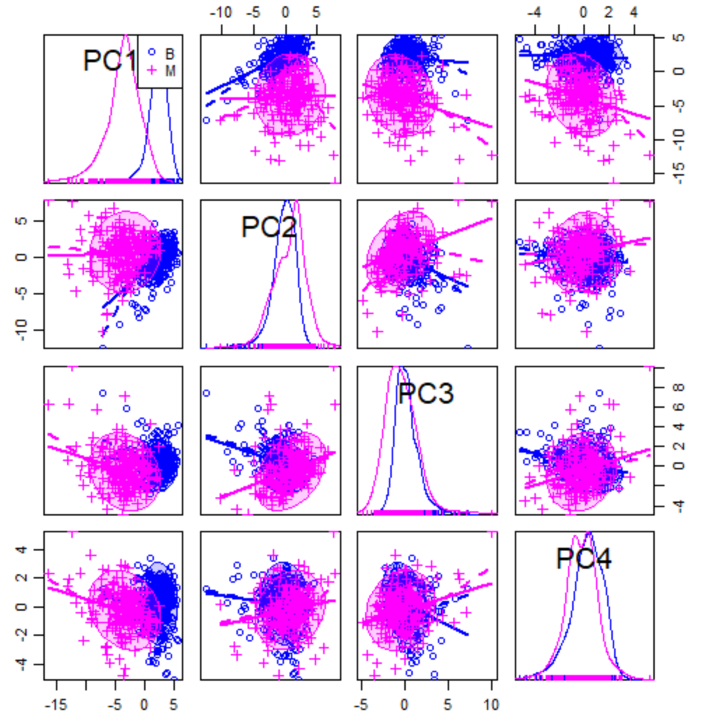
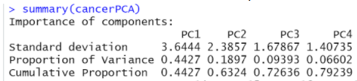
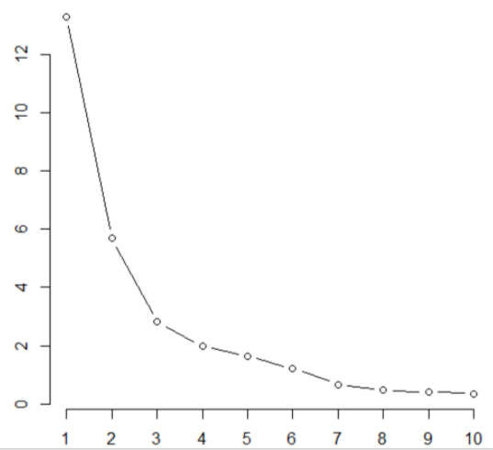
PCA
Used PCA like in midterm to choose optimal principal components. Decided to use the first 4 components.

Slide 5
Classification Algorithms Used
LDA/QDA
Logistic Regression
Classification Tree
Random Forest
Support Vector Machines
Neural Network
2 layers, 10 nodes per layer
Clustering Analysis
GMM
Hierarchical Clustering
K Means

Slide 6
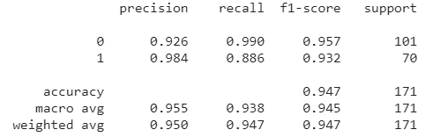
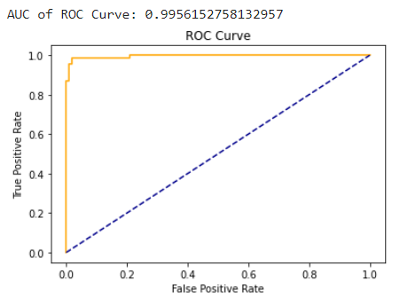
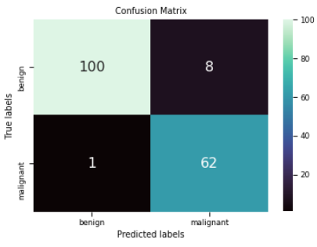
LDA
LDA misclassification error rate: 5.263

Slide 7
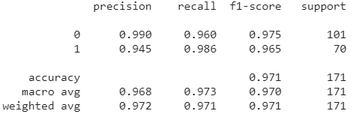
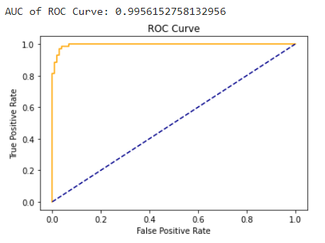
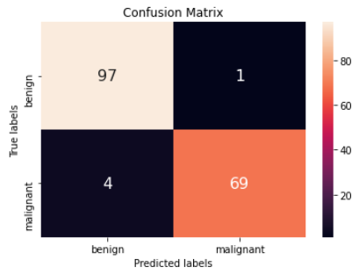
QDA
QDA Misclassification Error Rate: 2.92397

Slide 8
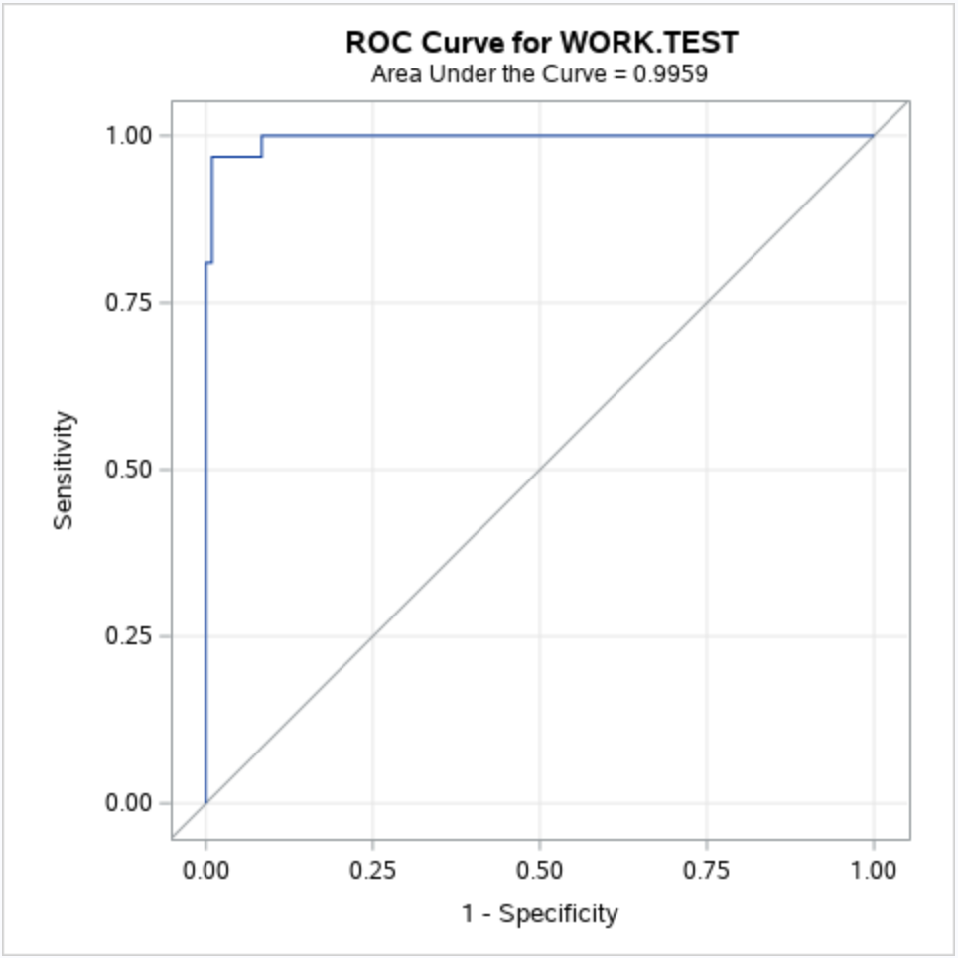
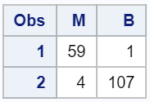
Logistic Regression with PCA
Test result
M
B
Misclassification error rate=5/171=0.0292

Slide 9
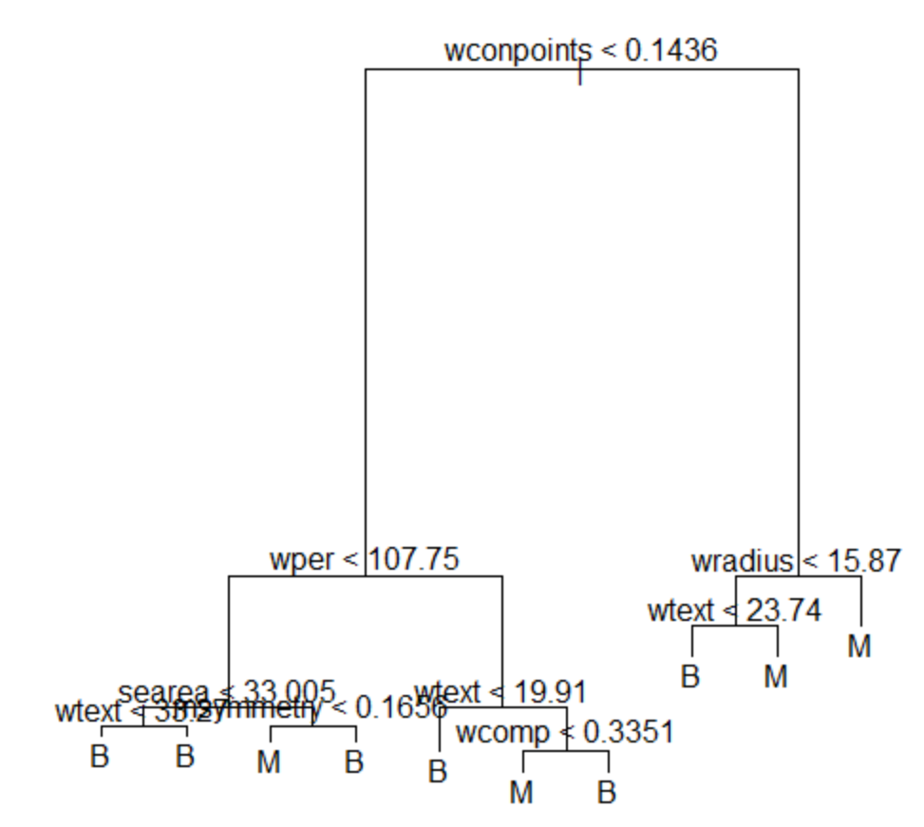
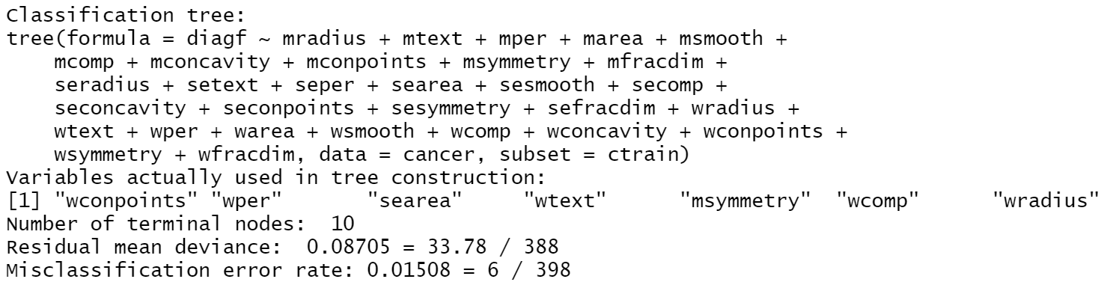
Classification Tree
We generated a classification tree first.
The tree has 7 variables and 10 terminal nodes. In training set, its misclassification error rate is 0.01508.

Slide 10
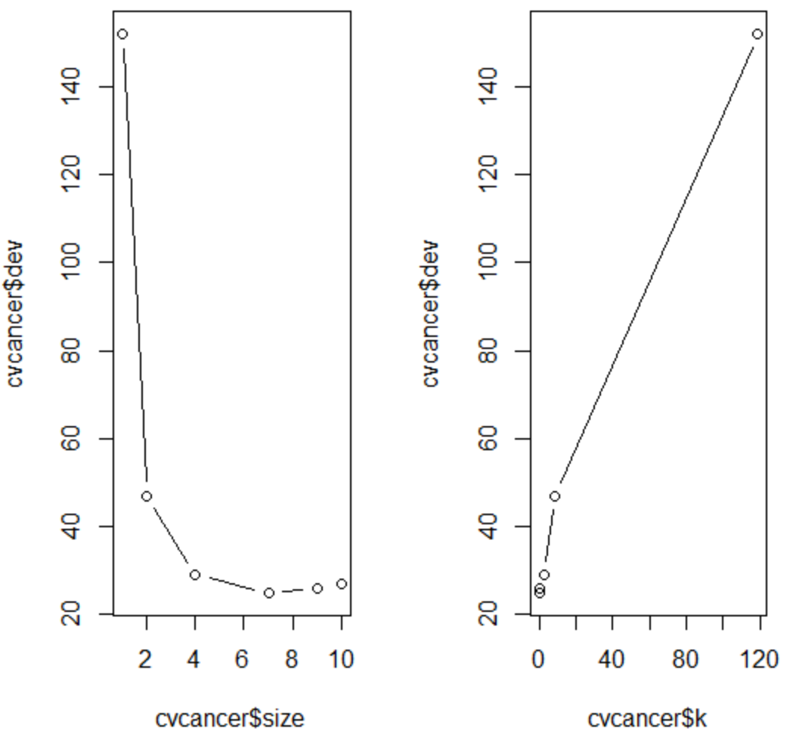
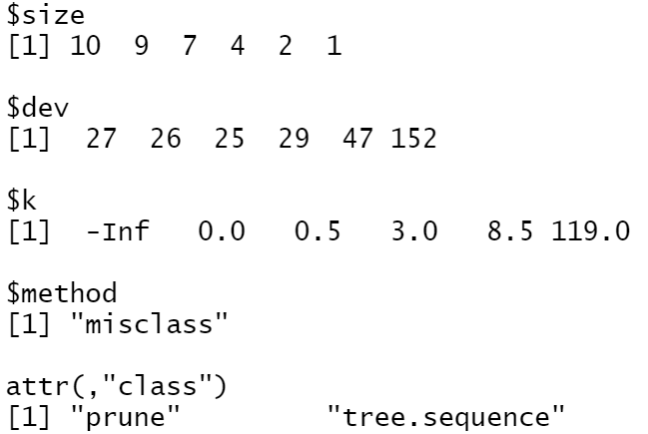
Classification Tree
Then we try to prune the tree:

Slide 11
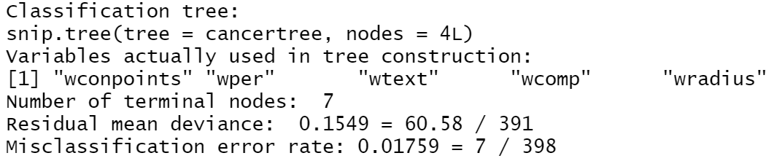
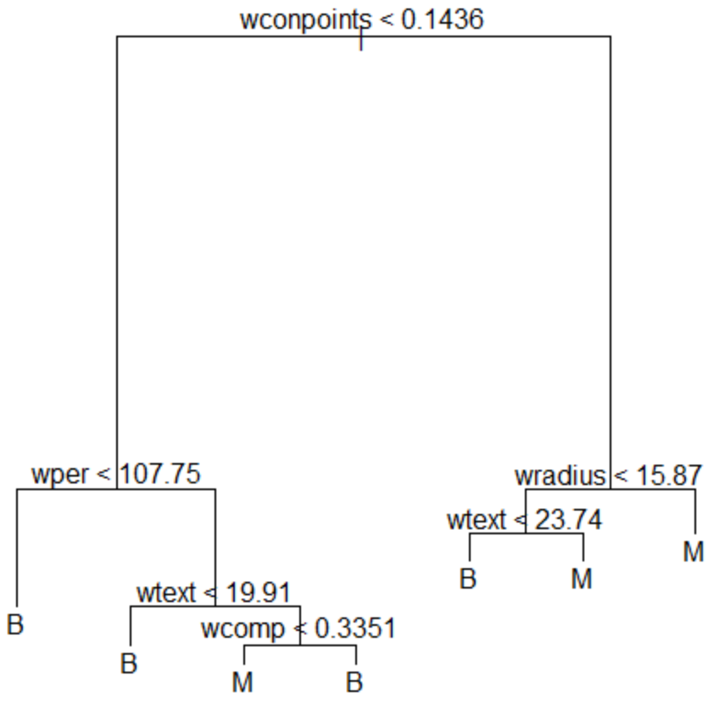
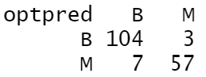
Classification Tree
Then to build the optimal classification tree:
By cross-validation
Misclassification error rate=10/171=0.0585

Slide 12
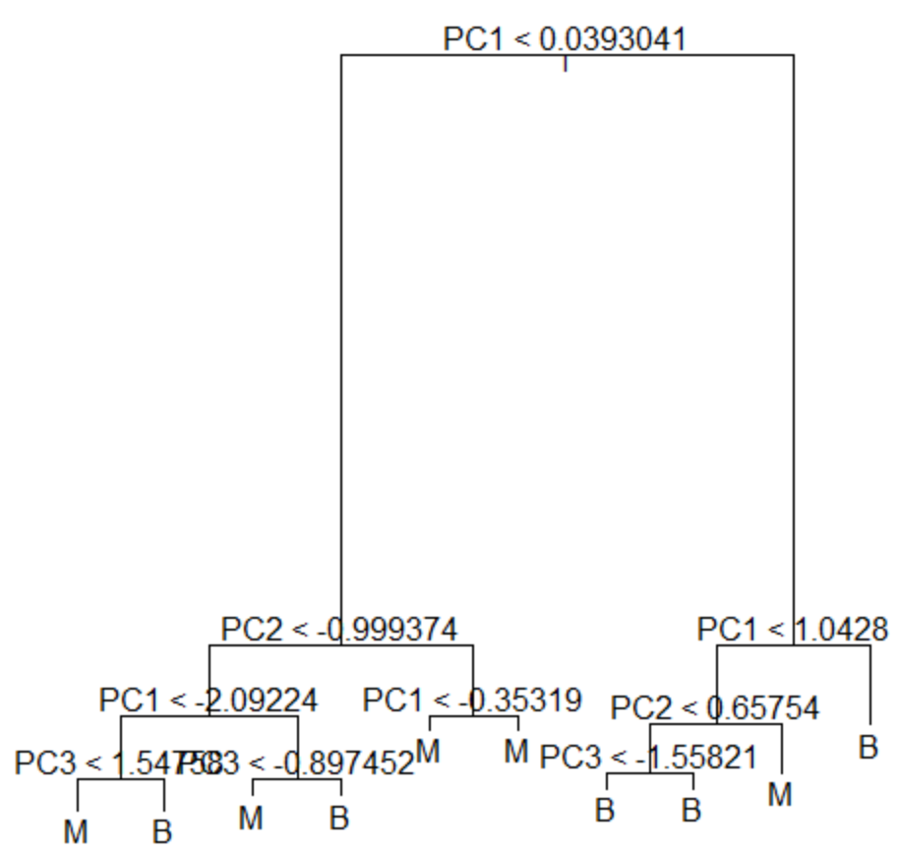
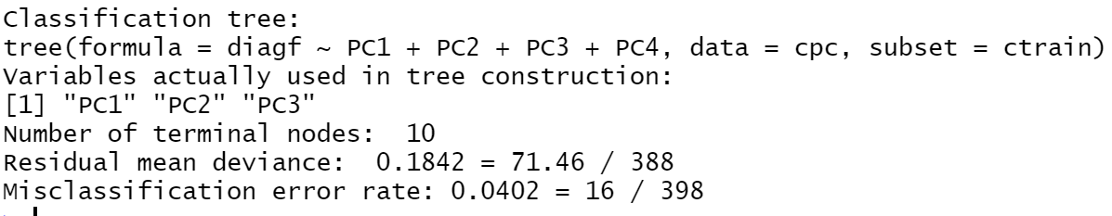
Classification Tree with PC
The tree has 3 variables and 10 terminal nodes. In training set, its misclassification error rate is 0.0402.

Slide 13
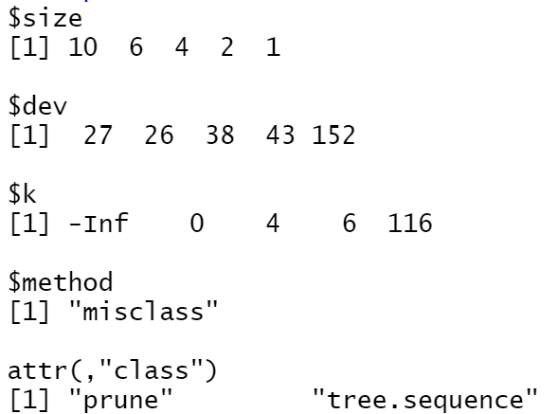
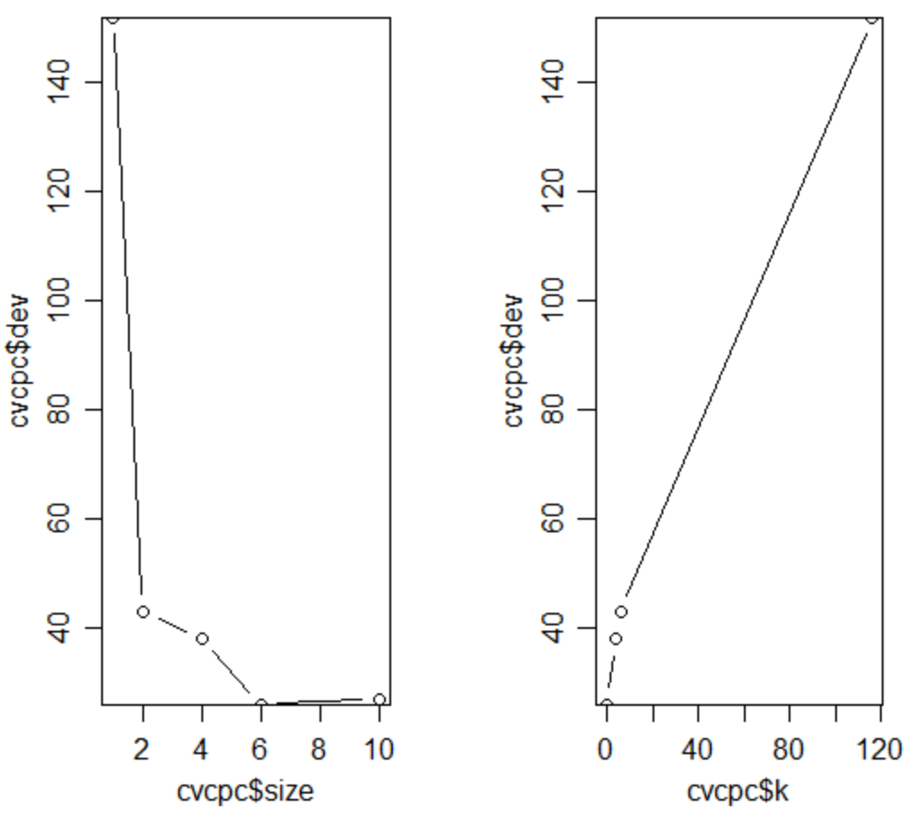
Classification Tree with PC
To prune the tree:

Slide 14
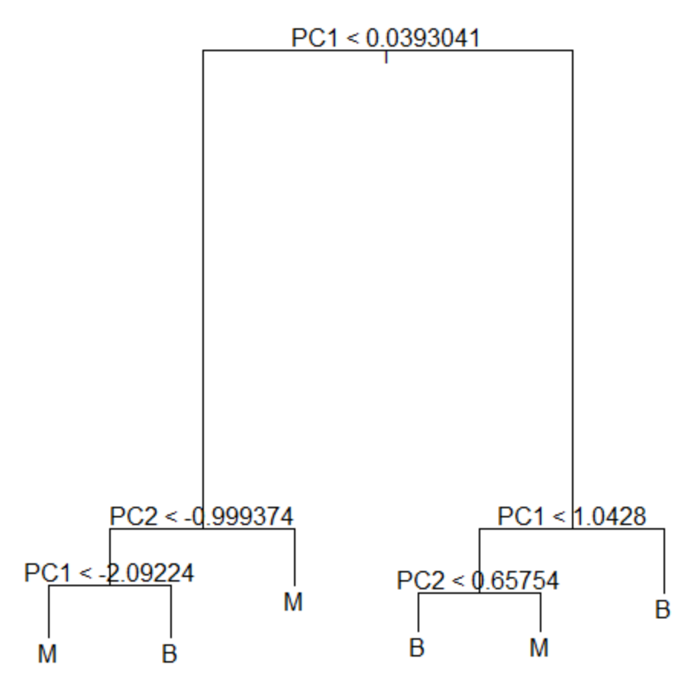
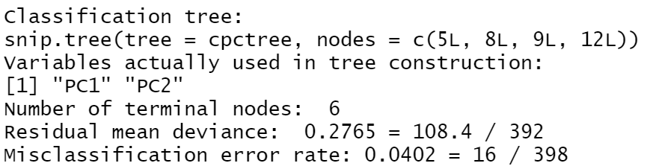
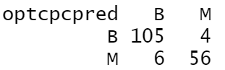
Classification Tree with PC
the optimal classification tree:
By cross-validation
Misclassification error rate=10/171=0.0585

Slide 15
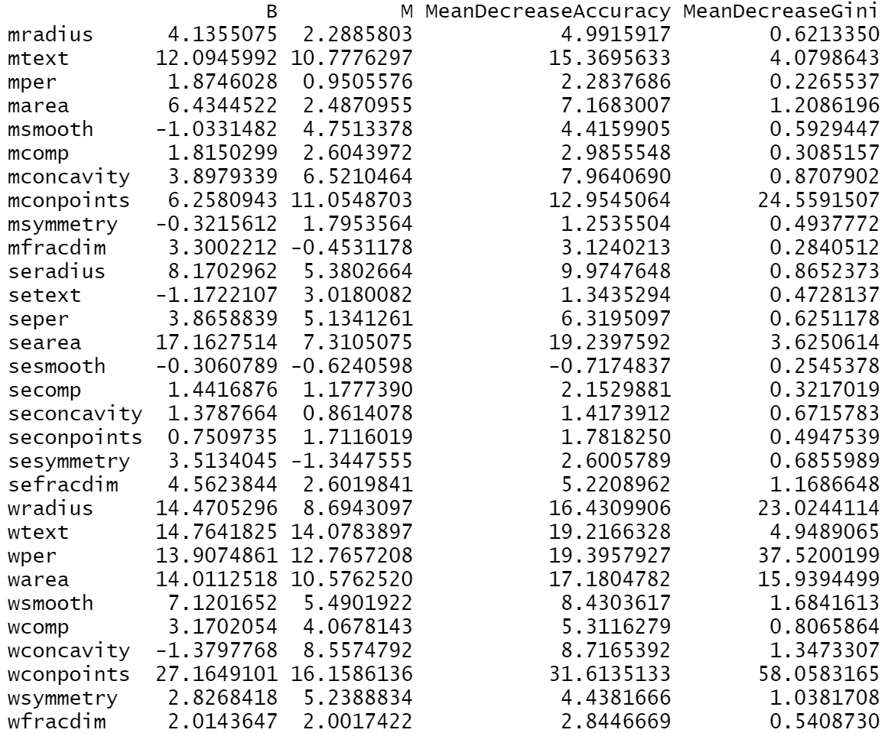
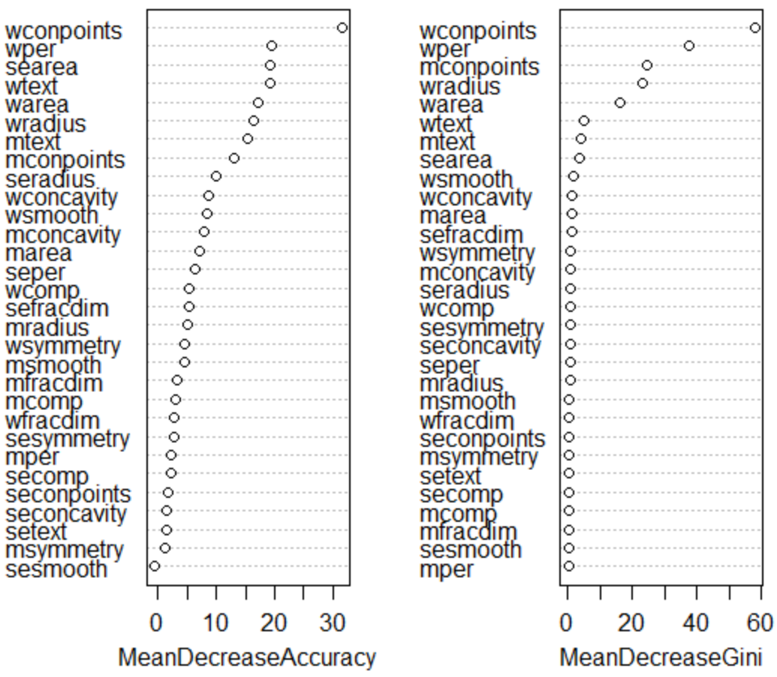
Random Forest
Checking the importance of variables:

Slide 16
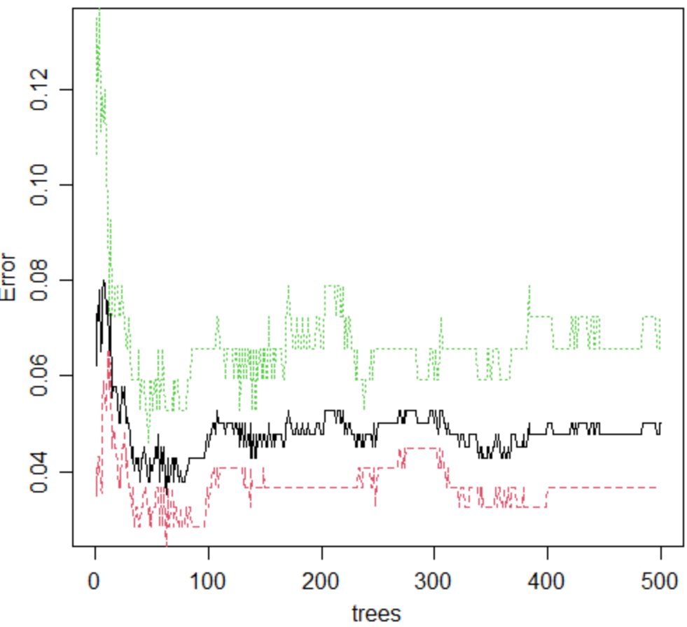
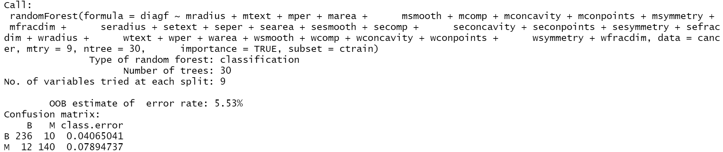
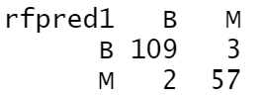
Random Forest
oob error versus number of trees
The final model
It has 30 trees and 9 variables tried at each split.
And for the test group,
Misclassification error rate=5/171=0.0292

Slide 17
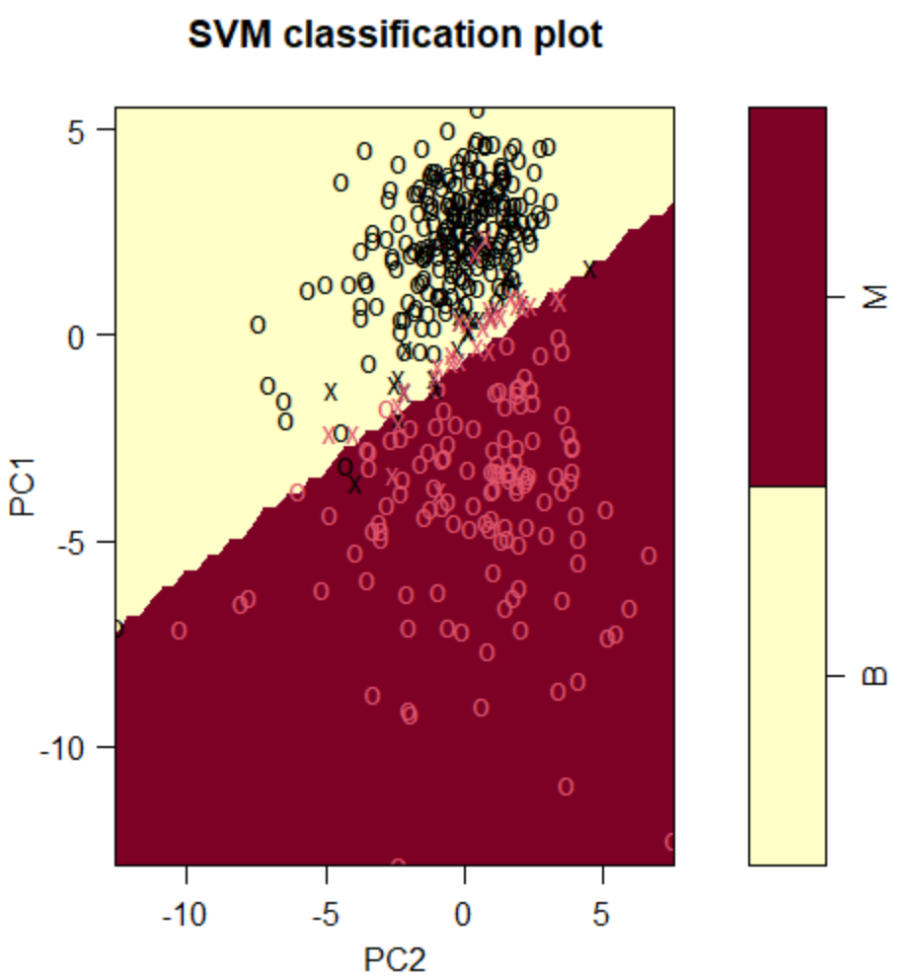
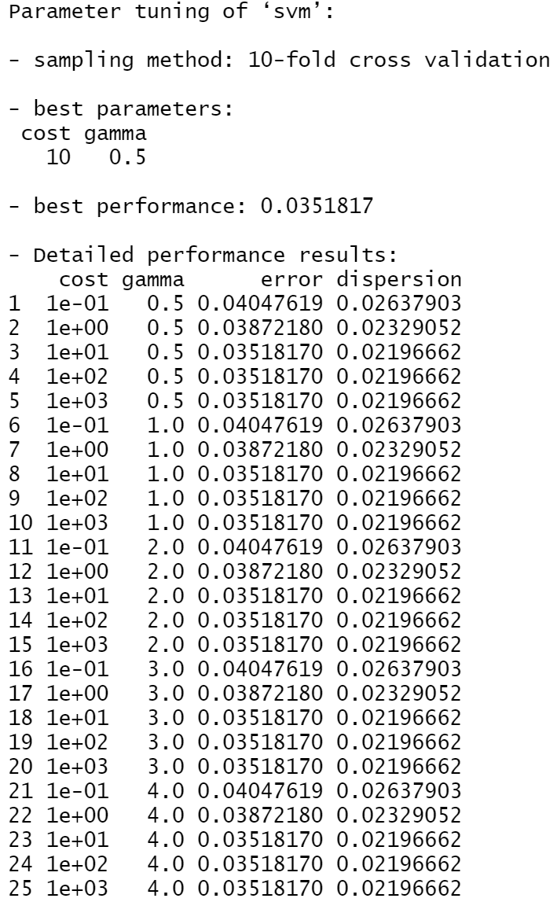
Support Vector Machine with PC
linear kernel

Slide 18
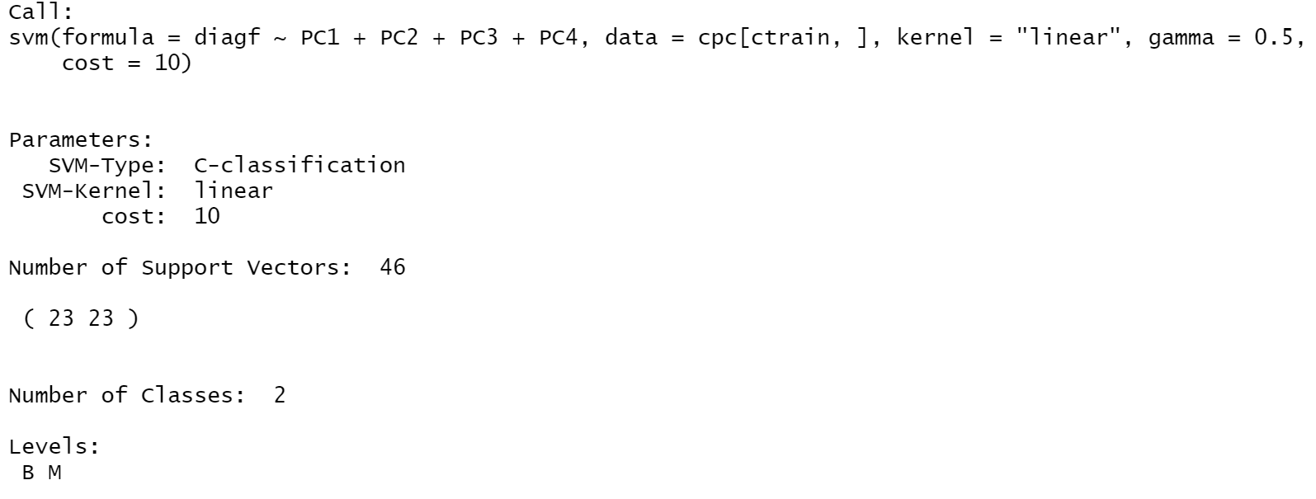
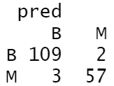
Support Vector Machine with PC
linear kernel best model
Misclassification error rate=5/171=0.0292

Slide 19
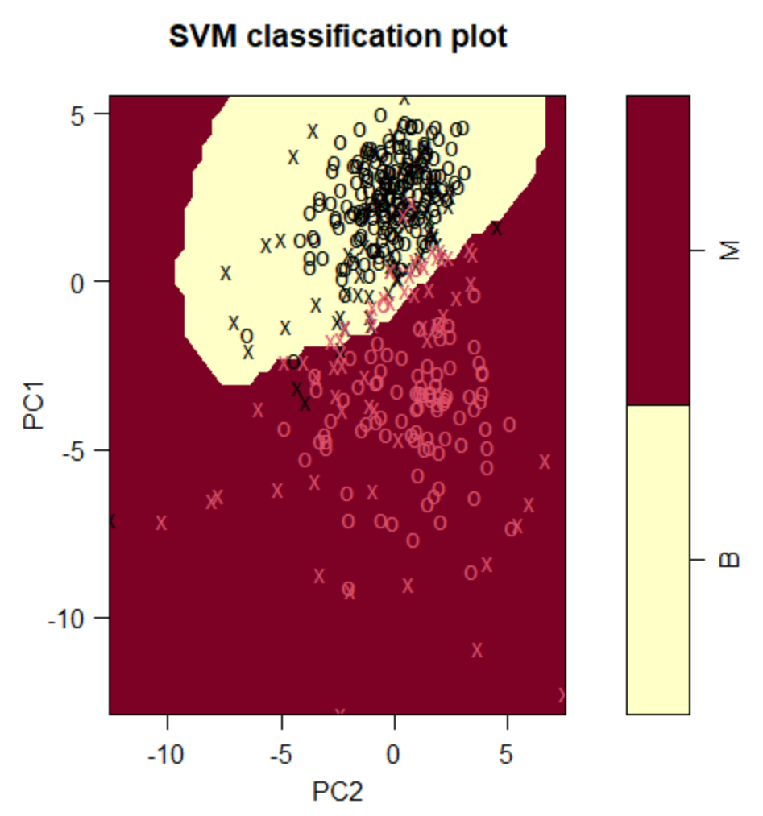
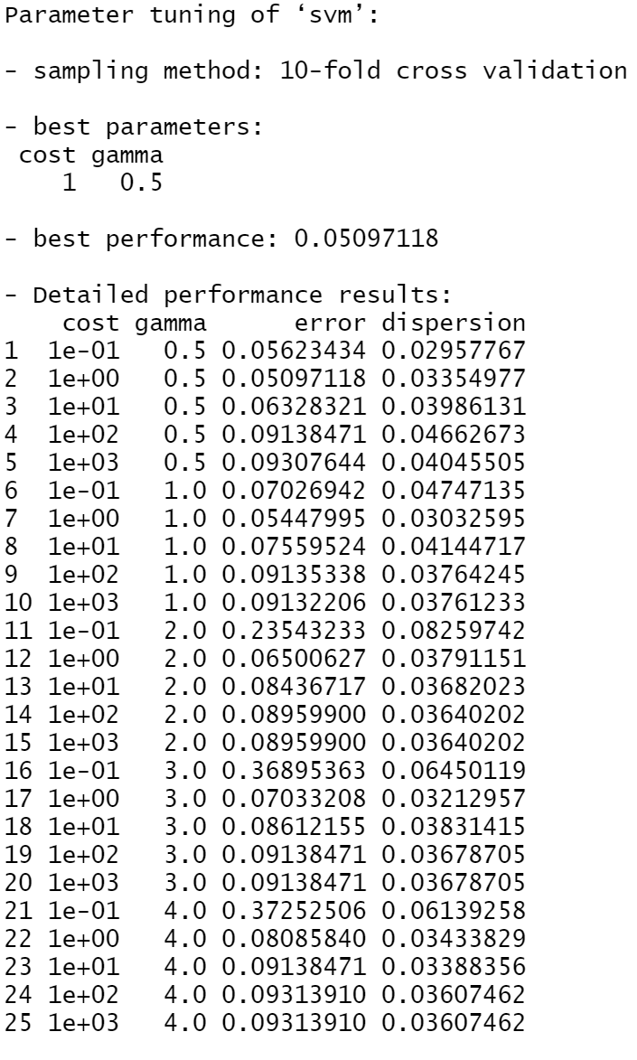
Support Vector Machine with PC
radial kernel

Slide 20
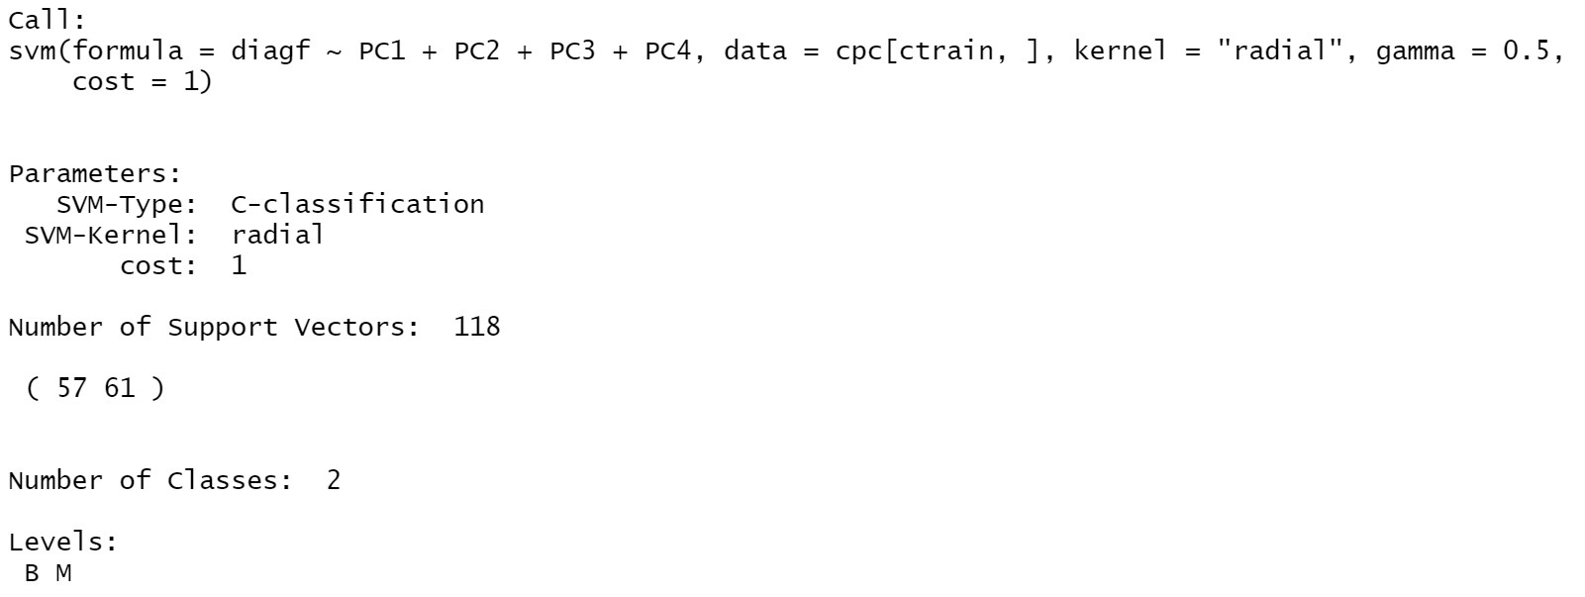
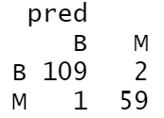
Support Vector Machine with PC
radial kernel best model
Misclassification error rate=3/171=0.0175

Slide 21
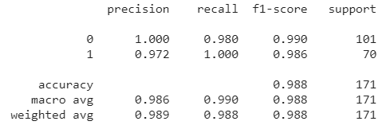
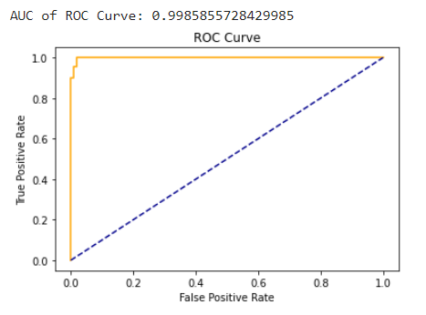
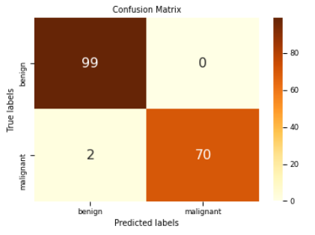
Neural Network
Neural Network Misclassification Error Rate: 1.169

Slide 22
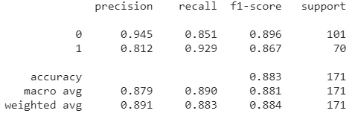
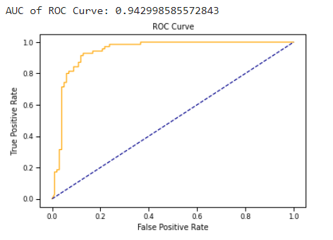
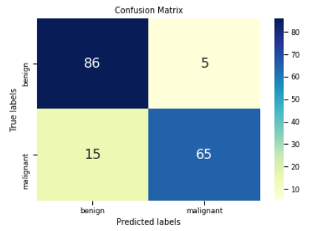
Gaussian Mixture Model
GMM misclassification error rate: 11.7

Slide 23
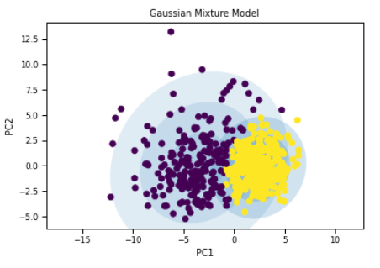
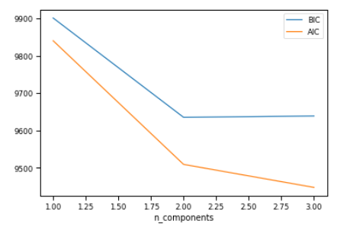
Gaussian Mixture Model
Chose two components because AIC and BIC remain relatively the same after two components.
Higher misclassification error rate than other models because pdfs for two gaussians overlap.

Slide 24
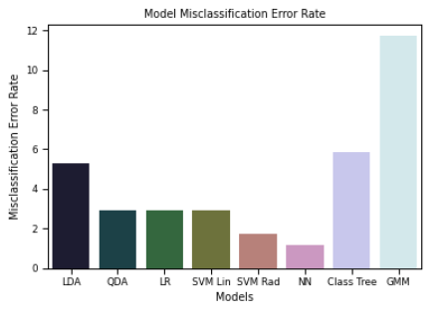
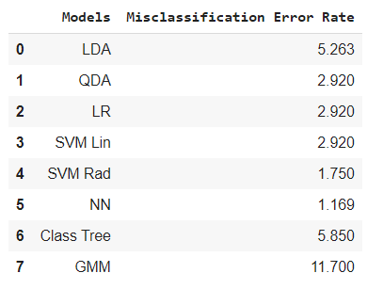
Classification Error Rate Comparison
Classification Tree has the highest misclassification error rate -> 17
Neural Network has the lowest misclassification error rate -> 1.169

Slide 25
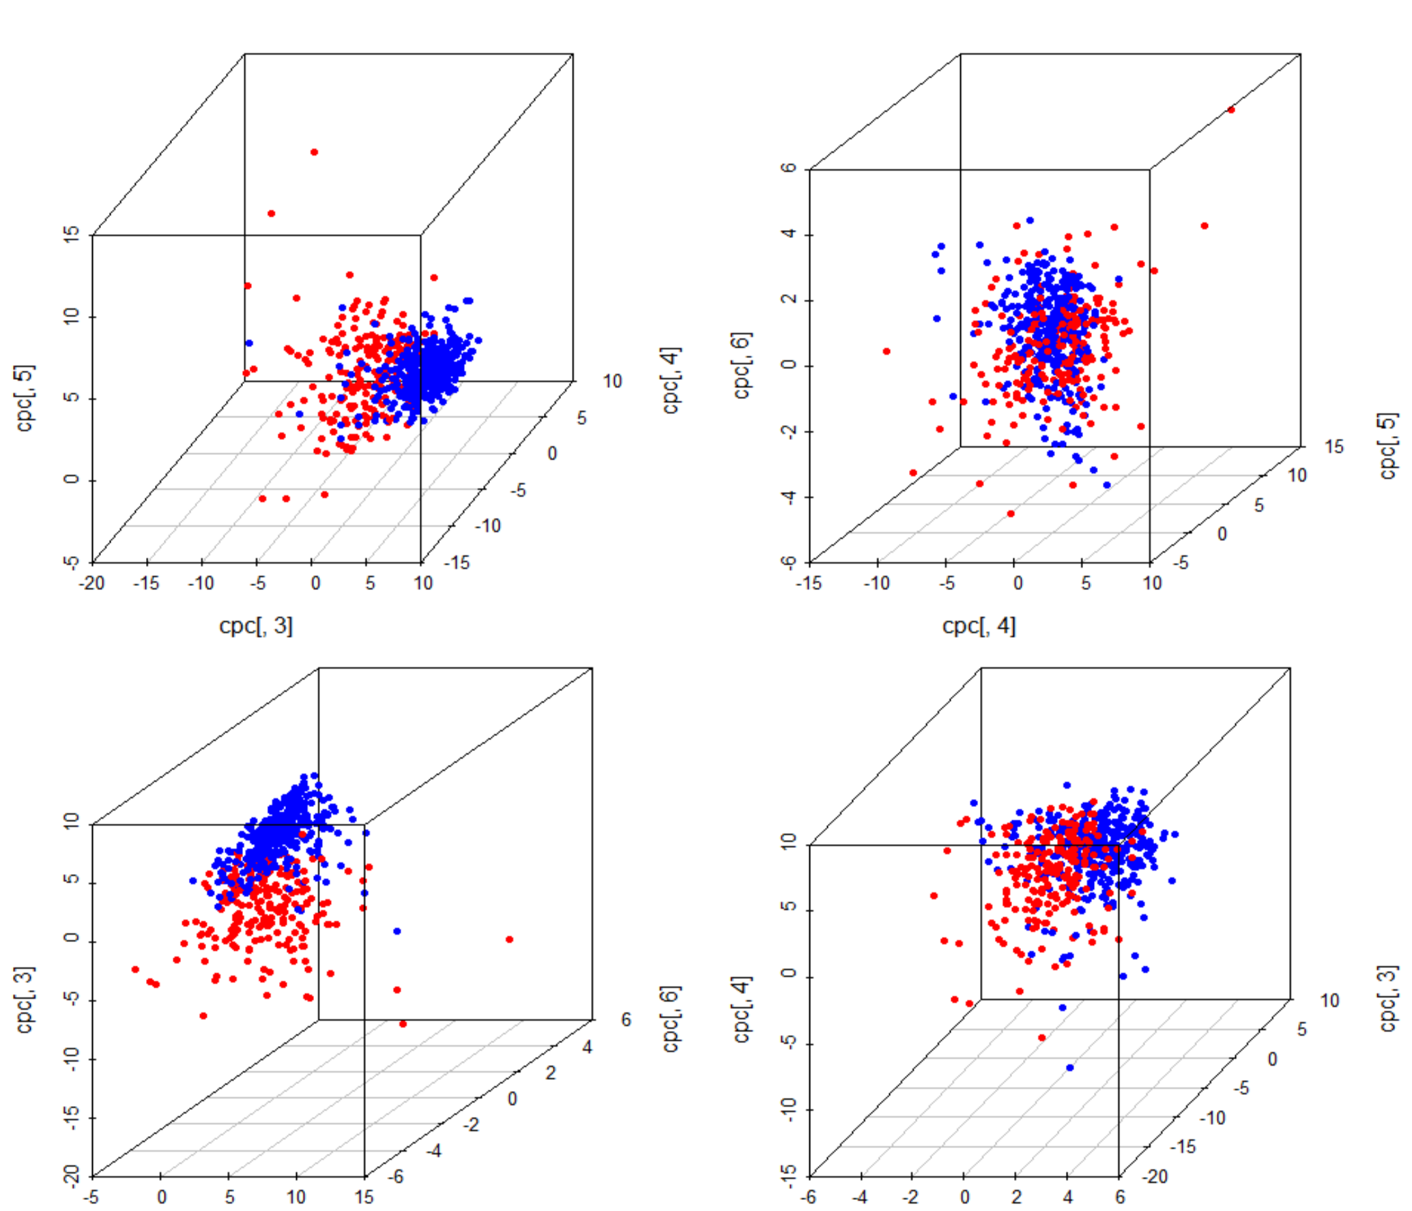
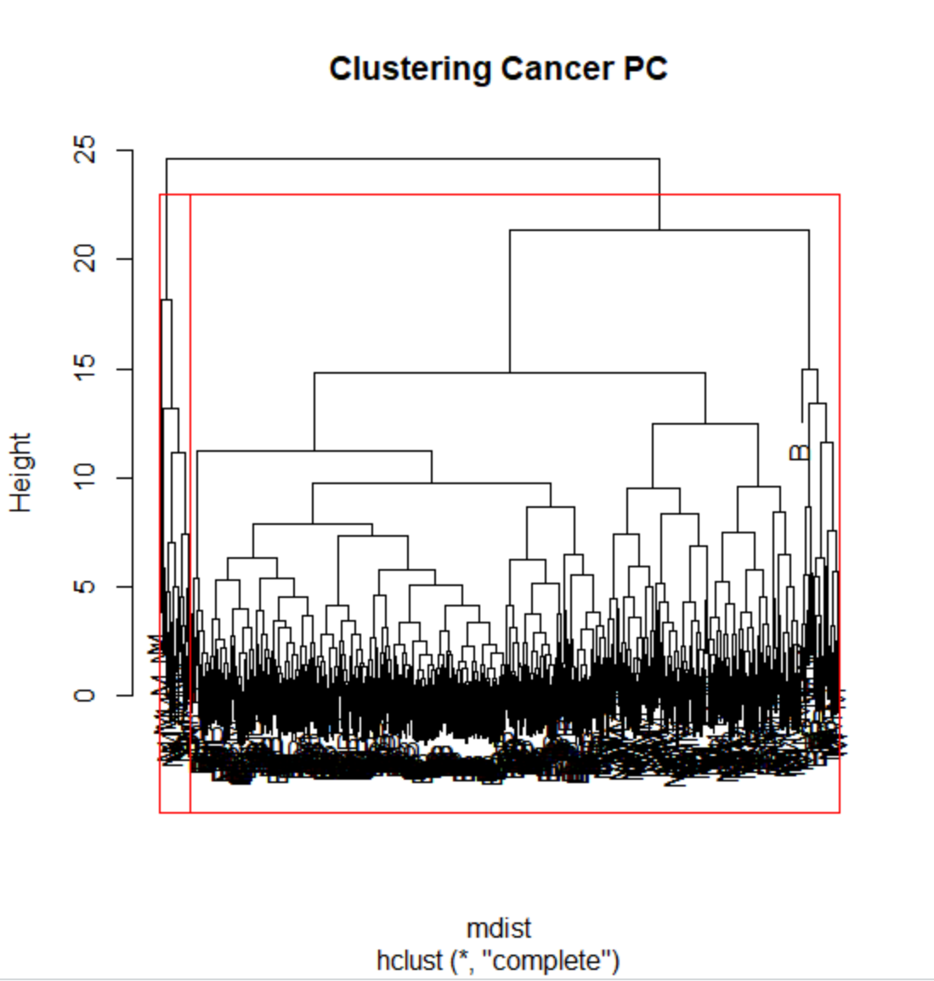

Clustering Analysis
Hierarchical Method
Cancer data
The optimal number of
clusters is 2
Compare with the original data
The size of the 2 clusters are 543 and 26

Slide 26




Clustering Analysis
K-Means Method
SS_total=8,039.543
Compare with the original data:

Slide 27
Q&A

